Slide 1
Networking Devices

Slide 2
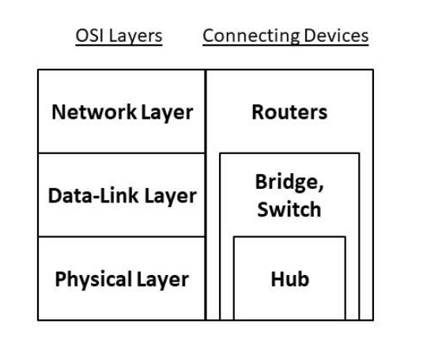
Networking Devices
Repeater
Hub
Bridge
Switch
Router

Slide 3
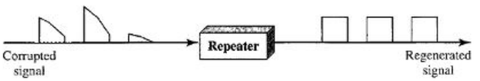
Repeater
A repeater operates at the physical layer.
Repeater regenerate the signal over the same network before the signal becomes too weak or corrupted.
so as to extend the length to which the signal can be transmitted over the same network.
It is a 2 port device.

Slide 4
Hub
It is also known as a Multiport Repeater Device.
A Hub is a layer-1 device and operates only in the physical network of the OSI Model.
It can connect devices of the same network only.
A Hub is not an intelligent device.
It does not maintain any address table for connected devices.
a hub broadcasts the incoming data packets in the network
It is less secure, as it broadcasts the data packet
In Hub, half duplex transmission technique is utilized.

Slide 5
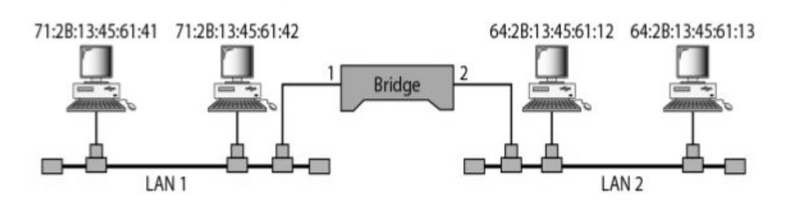
Bridge
A bridge is a layer-2 network connecting device, i.e., it works on the physical and data-link layer of the OSI model.
A bridge connects the devices which are present in the same network. It is mainly used to segment a network to allow a large network size.
It has two types of port - incoming and outgoing.
A Bridge has filtering capacity.
Improves security by limiting the scope of data frames.

Slide 6
Switch
A switch acts as a multiport bridge in the network.
A switch is a layer-2 network connecting device, i.e., it works on the physical and data-link layer of the OSI model.
A switch maintains a Switch table which has the MAC addresses of all the devices connected to it.
A Switch is an intelligent device with filtering capabilities

Slide 7
Switch
A switch is a multicast networking device that works under the Datalink layer of the OSI model and connects a bunch of computers or devices in a network.
a switch acts as the central interconnecting device that connects all the devices of a network in order to ensure proper resource sharing.
Basically, in a network, all the end devices like a computer printer, servers, etc. are connected through the switch

Slide 8
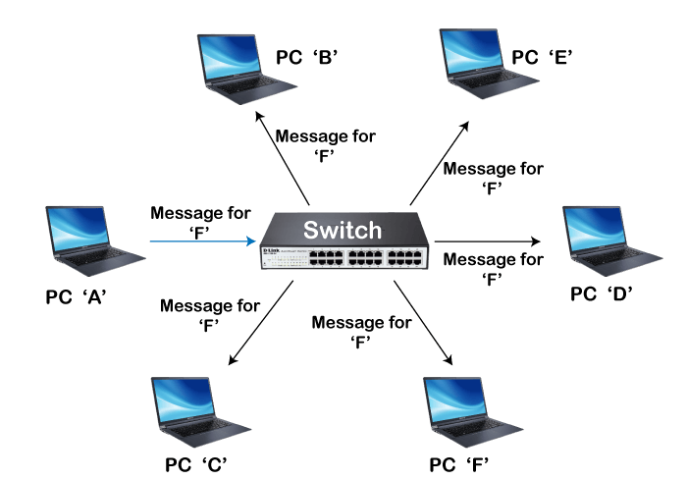
Switch

Slide 9
Router
A Router is a networking device that operates under the network layer of the OSI model and is used to connect two or more networks.
A router is a device that is used to interconnect various switches of different networks to form even a wider network.
A Router is a layer-3 network connecting device, i.e., it works on the physical, data-link and network layer of the OSI model.
A router maintains a routing table using the routing algorithms

Slide 10
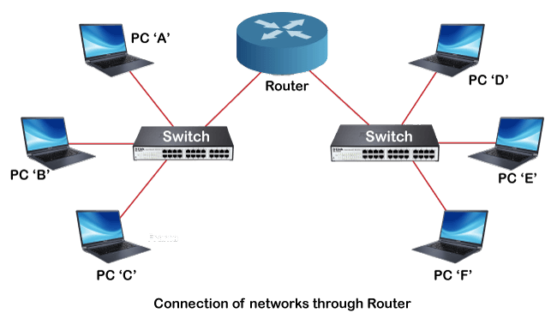
Switch & Router
Switch works on the data link layer of the OSI model.
The Router works on the network layer of the OSI model
Switch can join multiple devices within one LAN.
A Router can link both LAN as well as WAN.
Switch works based on the MAC address,
Router works based on IP address.

Slide 11
Network Addressing

Slide 12
Address
MAC Address
IP Address

Slide 13
MAC
A Media Access Control (MAC) address is a 48-bit (6 bytes) address that is used for communication between two hosts in an Ethernet environment.
It is a hardware address, which means that it is stored in the firmware of the network card (NIC).

Slide 14
MAC addresses are usually written in the form of 12 hexadecimal digits. For example, consider the following MAC address:
D8-D3-85-EB-12-E3

Slide 15
How to find out your own MAC address?

Slide 16
IP Address
An IP address is a 32-bit number that identifies a host on a network
An IP address is usually written in the form of four decimal numbers separated by periods (.)
Example
10.2.3.4

Slide 17
How to find out your IP address?

Slide 18
Using CMD
Using Google

Slide 19
Private IP address of a system is the IP address which is used to communicate within the same network. Using private IP data or information can be sent or received within the same network.
Public IP address of a system is the IP address which is used to communicate outside the network. Public IP address is basically assigned by the ISP.

Slide 20
Private addresses ranges
10.0.0.0 – 10.255.255.255
172.16.0.0 – 172.31.255.255
192.168.0.0 – 192.168.255.255

Slide 21
Which information can we get from IP Address?

Slide 22
https://viewdns.info/
https://www.whatismyip.com/
https://whois.domaintools.com/
https://www.whois.com/whois/
https://www.ipchecktool.com/tool/macfinder
182.73.197.20 (VIT)
182.72.39.10
182.72.39.9

Slide 23
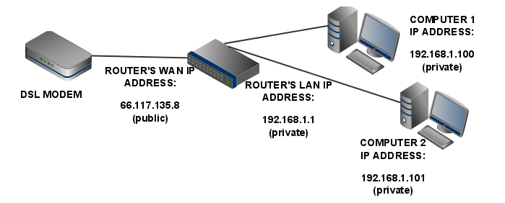

Slide 24
How to map from Private Address to Public and vice versa?

Slide 25
Network Address Translation (NAT)
Network Address Translation (NAT) is a process in which one or more local IP address is translated into one or more Global IP address and vice versa in order to provide Internet access.

Slide 26
Default Gateway
Default Gateway: is an intermediate device between the local network and Global Network.
CMD: Tracert <Domain/IP>

